Slide 1
IEEE Project Competition
Week 6: Technical Assistance

Slide 2
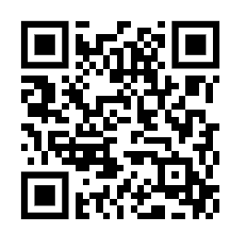
Attendance

Slide 3
Overview
November 30th, BOM’s are due.
Keep researching topics, and find components that might be useful.
Ask questions.
Check discord.
Sketch and draw out your systems!
Github workshop next week.

Slide 4
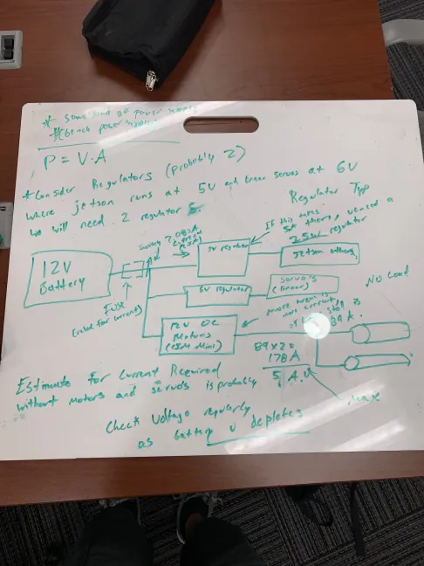
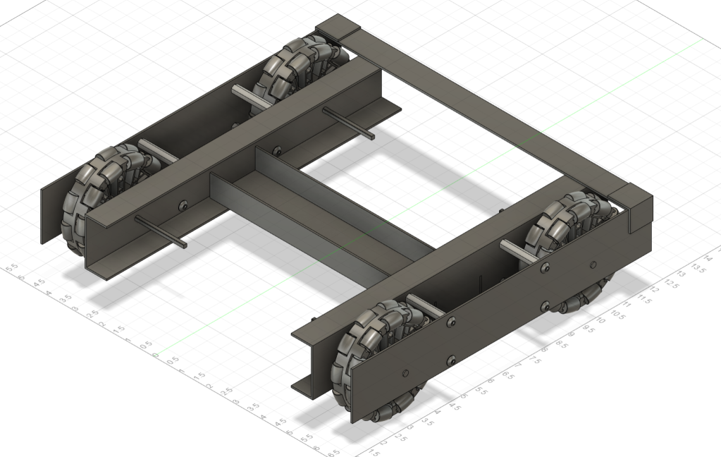
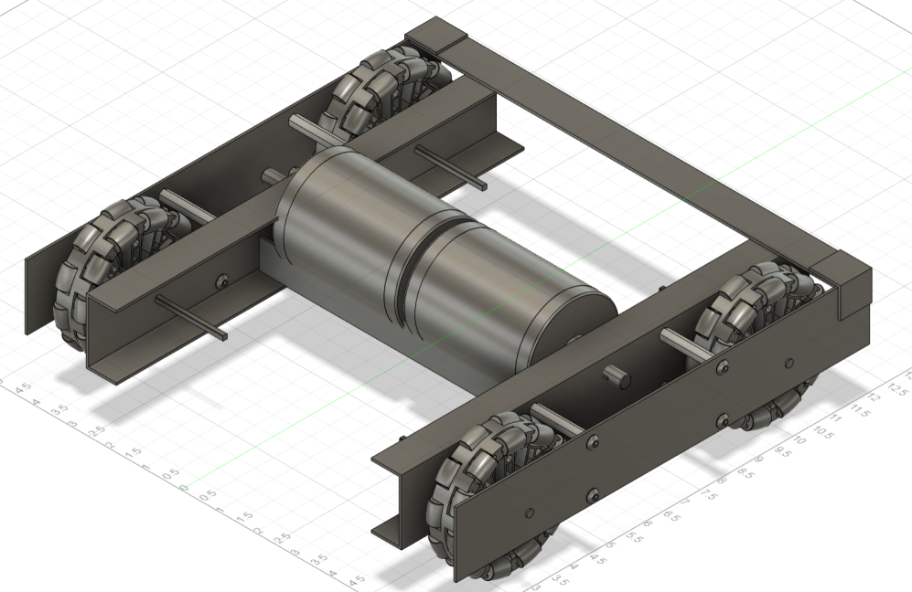
Schematic Examples

Slide 5
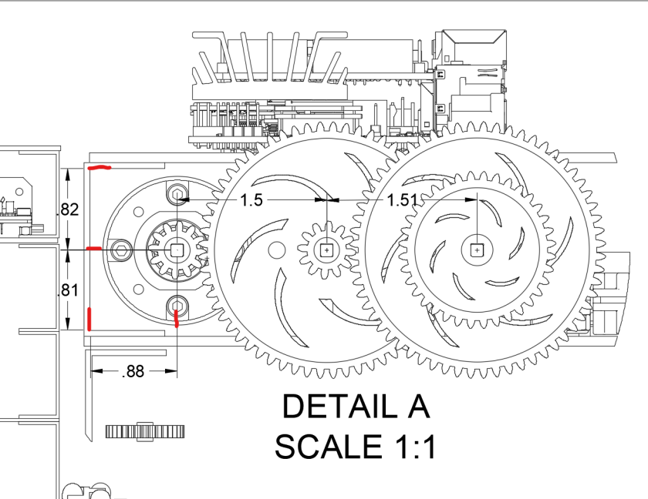
Schematic Examples

Slide 6
Implementation Testing and Prototyping
VIDEO

Slide 7
Finalized Teams
Electric Skateboard (Mini) - Beginner | Block Moving Robot - Advanced | Audio Visualizer - Beginner (individual) | Arcade Game - Advanced (individual) | Floating Magnet - Beginner (Individual) | Batmobile - Beginner | LED Pitch Changer - Beginner | Climbing Robot - Beginner | Mobile Game - Beginner | Knightboy- Advanced
Evan Eichholz, Bree | Eric Segrest, Abdiel, Mike (maybe) | Alexander | Aldem | Joshua Guo | Amy Diaz, Liani Garcia, Jennifer | Landon Luke, Ryan Moran, Samuel Hustin | Viviana, Frankey, Rolando, Keya | Joshua, Jacob, Jason | Scott …
Airpodsred, breemars56 | MrE9000, thebackdimple , _dasanii | limes1 | syndric | tallasian0281 | Tedpluto, lenedinal | Landonluke, rmoran24 | LanceEvo,Madeem, amnotkt | Espial7, Funnmy, jasr321 | .planky.

Slide 8
Timeline and Important Dates
Weekly Meetings - Estimated Timeline
Week 1 | Week 2 | Week 3 | Week 4 | Week 5 | Week 6 | Week 7 | Week 8 | Week 9 | Week 10
Introduction | Microcontrollers - Erik | Fusion 360/Solidworks - Matias | KiCAD -Tino | General Project Management Skills/ Github/ BOM’s | Technical Assistance Focused | Git and GitHub Workshop | Technical Assistance Focused (Veterans Day) | Intro to Sensors | Winter Break (BOMs due 30th Nov)

